Slide 1
Final Software Project
CST499: Capstone for Computer Software Technology
Instructor: Charmelia Butler
By Aenoy Inthanongsak
08/28/2023

Slide 2
Title and Content Layout
Summarize the key aspects of the SRS document that you developed.
Showcase the UML design model that you created.
Explain the design of the landing, login, and enrollment pages that you created.
Explain the MySQL database and class registration that you developed.
Discuss the PHP code that you wrote for this course.

Slide 3
Summarize the key aspects of the SRS document that you developed.
The Software Requirements Specification is intended to record and depict the arrangement between the client and the engineer with respect to the detail of the programming item mentioned. Its primary purpose is to provide a clear and descriptive “statement of user requirements”. This document is divided into several sections to logically divide the software requirements into parts that are easy to find.
The purpose of this product is to resolve the Registration System Problem by creating a new user registration system that addresses the provided requirements.

Slide 4
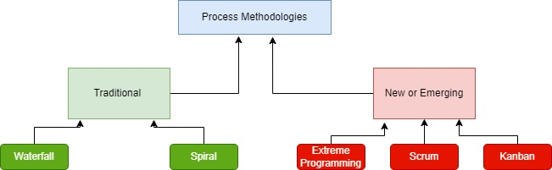
Showcase the UML design model that you created.

Slide 5
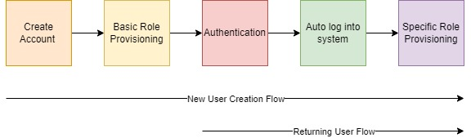
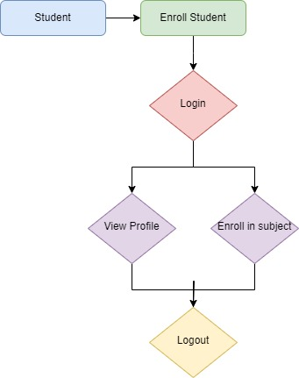
UML design

Slide 6
Explain the design of the landing, login, and enrollment pages that you created.

Slide 7
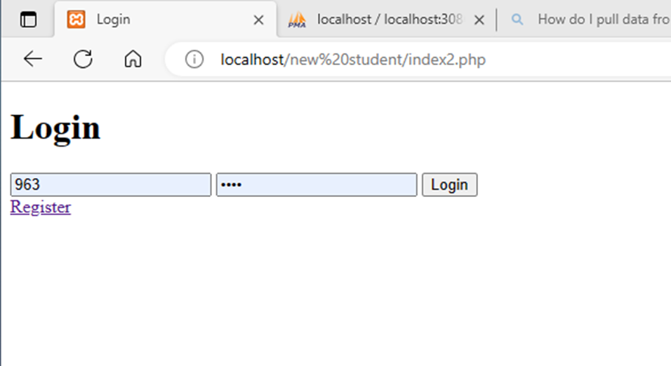
Login page
Utilizing user ID and password to login
Simple design
Register link for new user

Slide 8
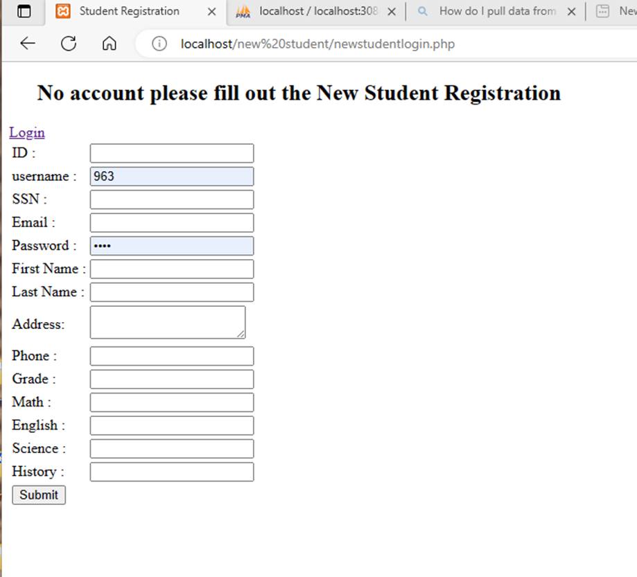
Enrollment Page
Simple line box
Require user ID and password to store in table for login purposes
Personal info for identification
Classes that needs to be added or deleted

Slide 9
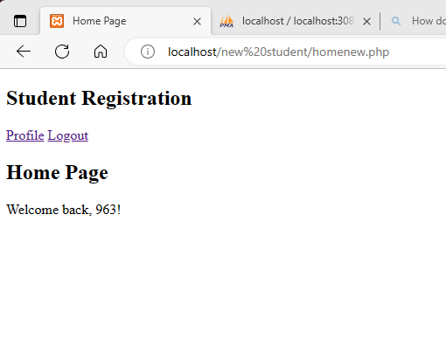
Landing Page
Shows the Username
Link to profile information
Link to logout of site

Slide 10
PHP code
database “new student user” with table “tbluser2”. The table also includes ID/ username/ SSN/ Email/ Password/ FirstName/ LastName/ Address/ Phone/Grade/Math/English/Science/History.
Next, I create the main dashboard page by writing the HTML page layout code which included all the column in the corresponding table.
After that, I wrote the source code for the PHP for inserting the data into the database as well as creating a connection between the database and the PHP.
Then I entered the information into the webpage/registration page then the data populated in the database “new student user”.
For the next Task we have to create the page for the login this page will display the UserID and Password.
I had to write HTML for this page. However, in order for this page to pull the data from the database I had to create a few different PHP source codes and I created different files.
I create the folder and put each of the different files in this folder: NewStudenlogin Index2, Authenticatenew, Profilenew, Homenew, and logoutnew.
Once the files are created, I had to write the code that corresponded with each page.
The index2 is just the html file.
The Authenticate code will check the users, connect to the database, validate form data, retrieve database information and redirect to a new page.
Home page is the page for logged-in users which won’t come up unless the username and password is working.
The profile page will pull data stored from the table and show the result on the page.
Logout will close out the session and redirect the user to the login page.

Slide 11
Reference
How to create a GitHub account. (n.d.). Www.youtube.com. Retrieved August 1, 2023, from https://www.youtube.com/watch?v=f_XsJIHSLRg
Software Requirements Specification (SRS). (n.d.). SearchSoftwareQuality. https://www.techtarget.com/searchsoftwarequality/definition/software-requirements-specification
Tsui, F. F., Karam, O., & Bernal, B. (2018). Essentials of software engineering. Jones & Bartlett Learning.
Walpita, P. (2019, May 20). Quality Attributes in Software Architecture. Medium. https://priyalwalpita.medium.com/quality-attributes-in-software-architecture-cacffe0995aa

